Slide 1
Swedish Wooden sculpture Homepage (Introduction & Sales)
18/02/2020

Slide 2
External user’s goal
Potential customer or cooperator (individual or organization)
- Wants to get information about wooden sculpture (Dala horse and wooden rooster) - Views to the wooden sculpture gallery
- Makes inquiries about general information/purchase/ cooperation/other
Consumer
- Wants to buy wooden sculpture

Slide 3
Site owner’s goal
Introduce Dala horse and wooden rooster
Sell wooden sculptures

Slide 4
Potential features to include
Information about wooden sculptures
Gallery
Purchase
Information about offline shop
Contact

Slide 5
User Scenario

Slide 6
User case diagram

Slide 7
Information Architecture
Home
Information
Dala horses
Roosters
Gallery
Purchase
About us
Dala horses
Roosters
Our store
Contact us

Slide 8
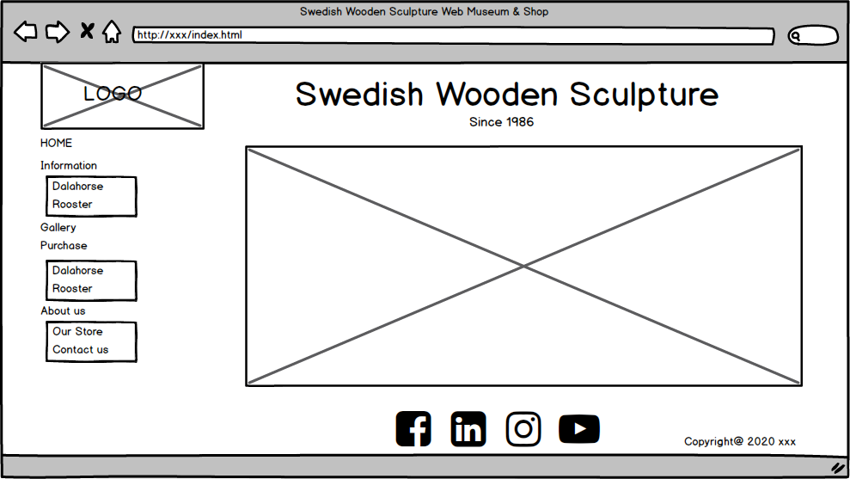
Mockup of the site

Slide 9
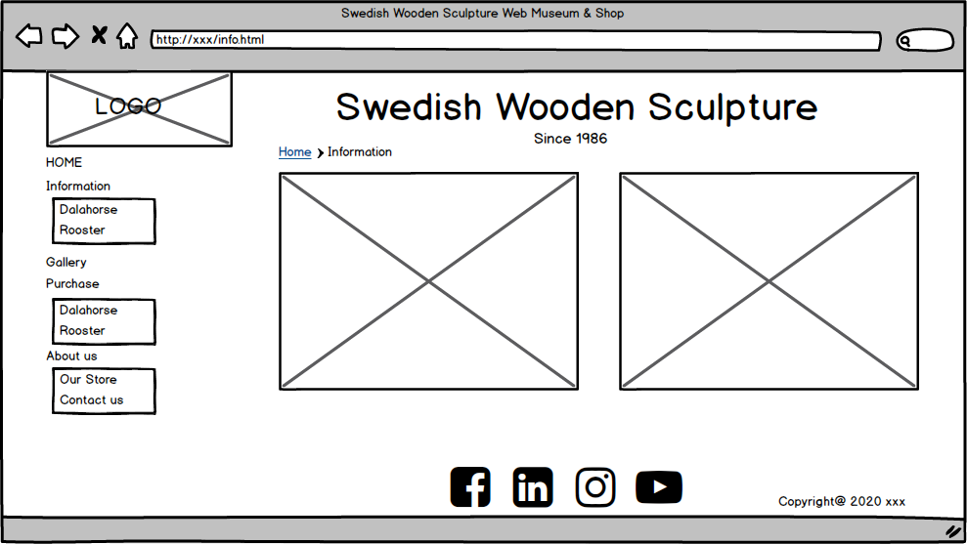
Mockup of the site

Slide 10
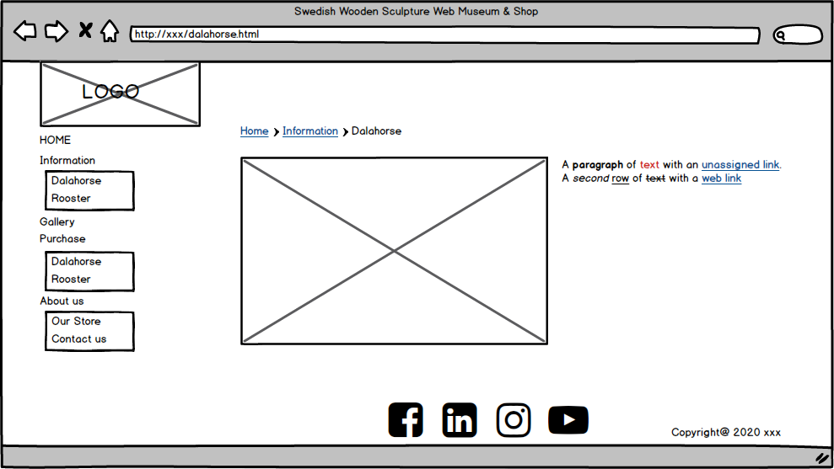
Mockup of the site

Slide 11
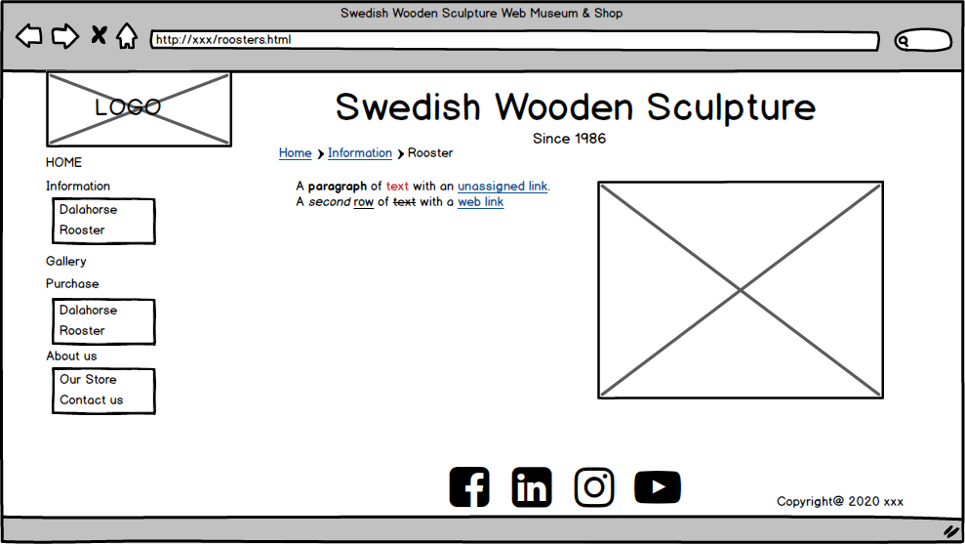
Mockup of the site

Slide 12
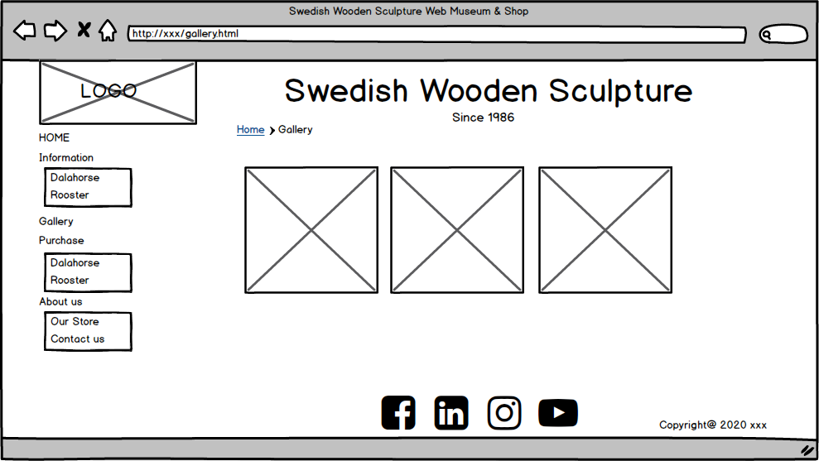
Mockup of the site

Slide 13
Mockup of the site

Slide 14
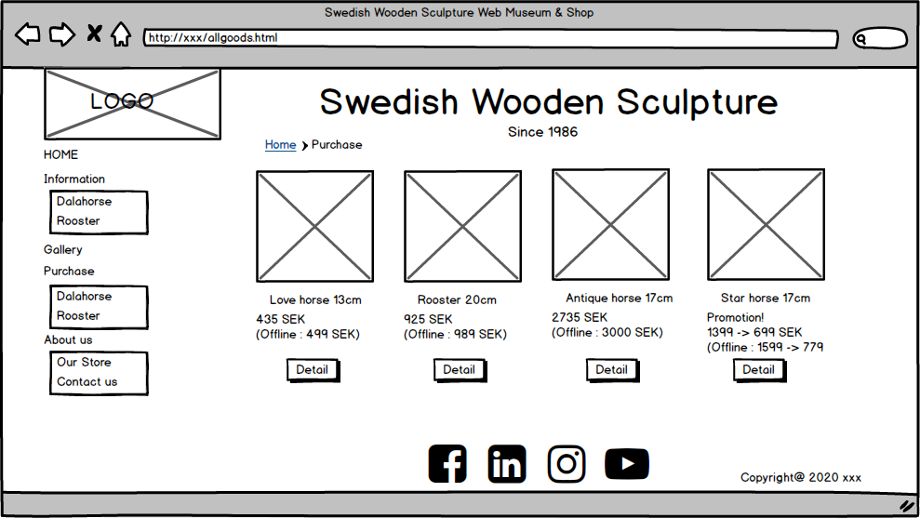
Mockup of the site

Slide 15
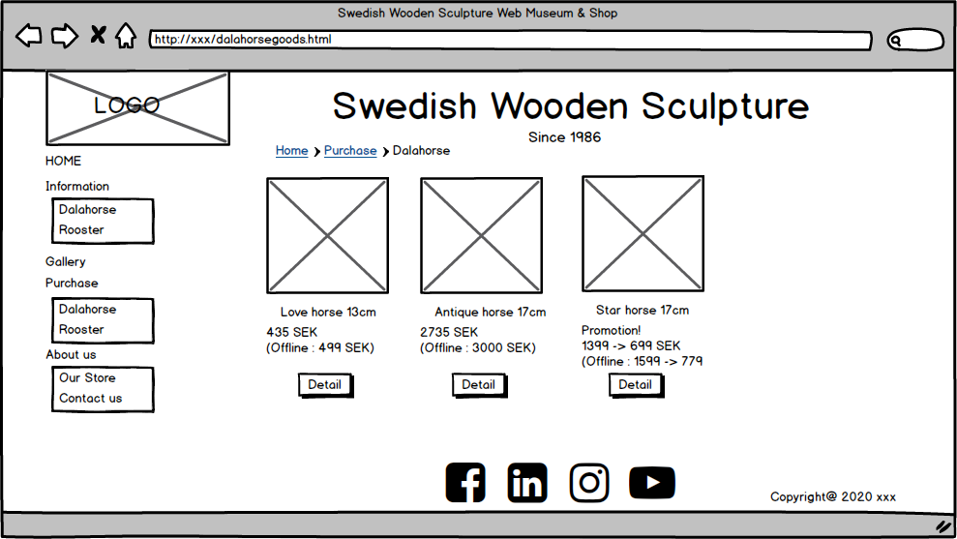
Mockup of the site

Slide 16
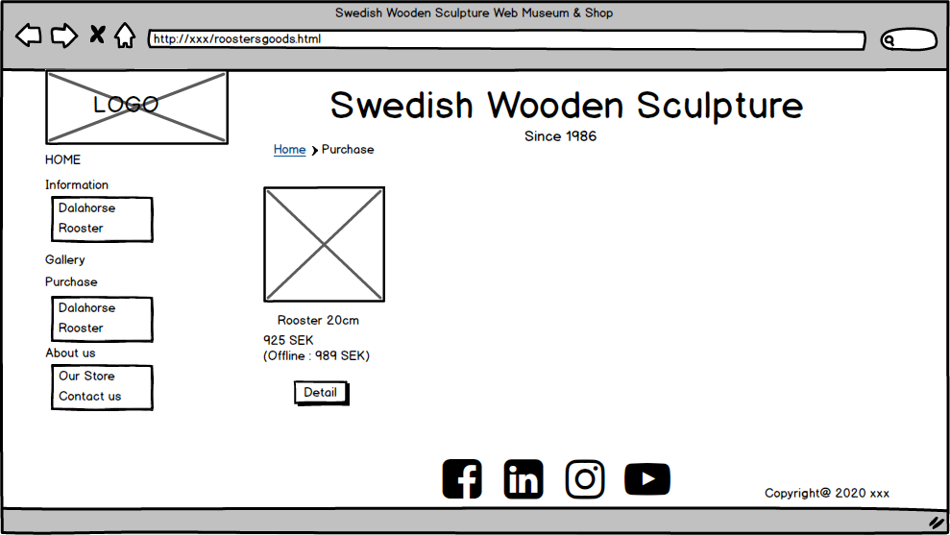
Mockup of the site

Slide 17
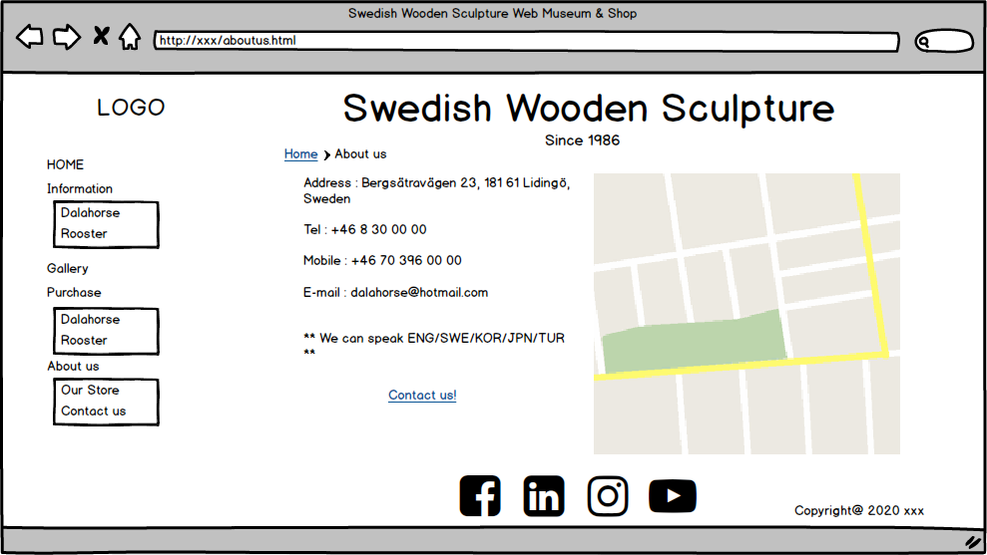
Mockup of the site

Slide 18
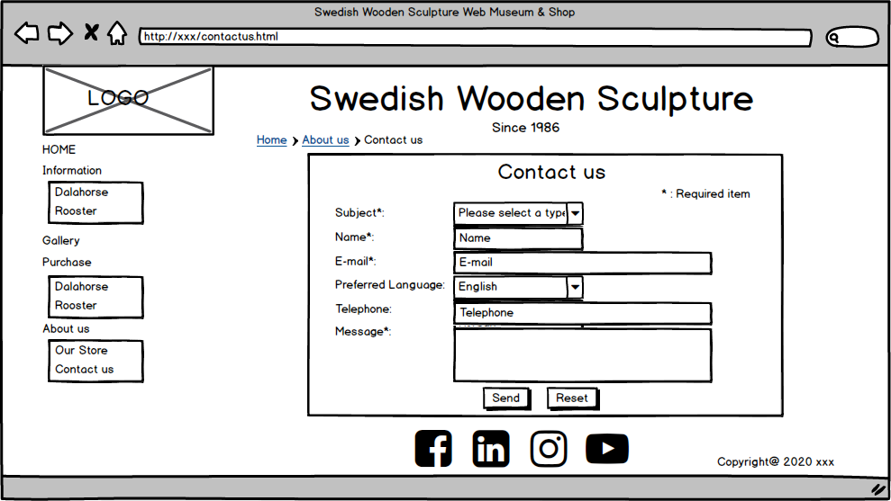
Mockup of the site

